Slide 1
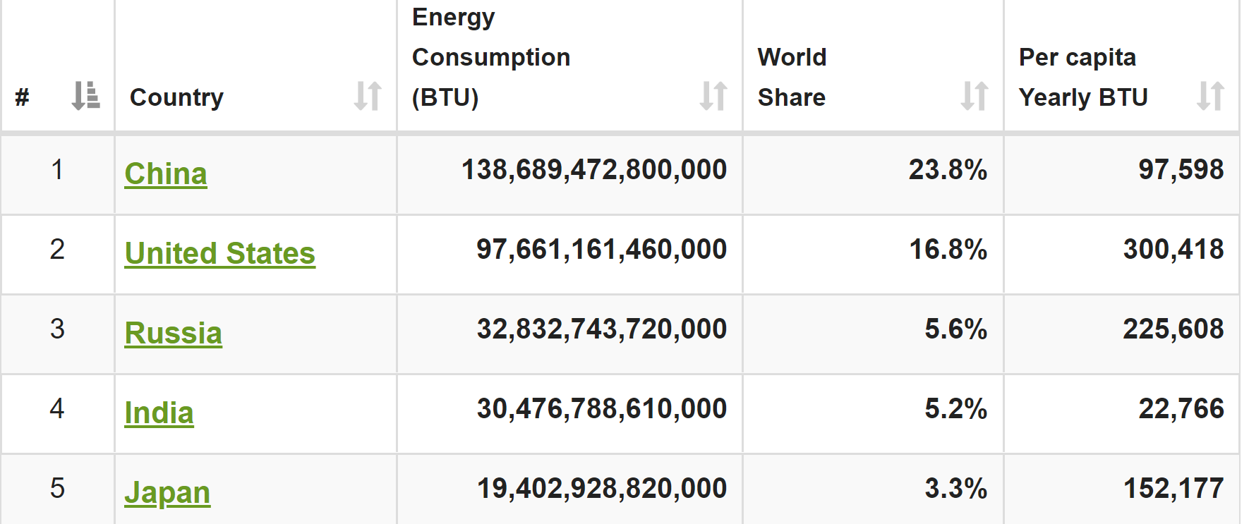
ENERGY USAGE
Source: World meters

Slide 2
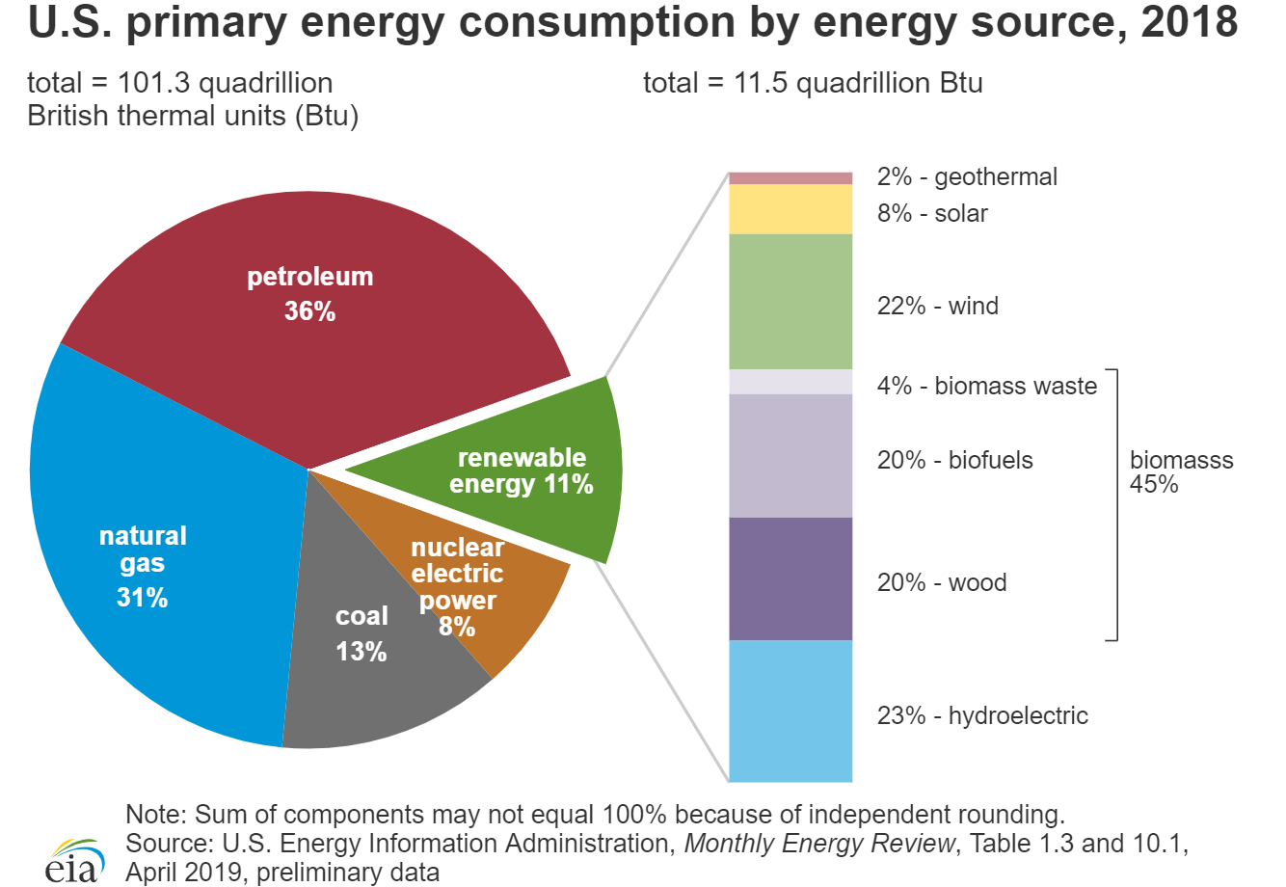

Slide 3
ENERGY USAGE
Us primary source is fossil fuel
Decided on of fossil fuel

Slide 4
approach
Us primary source is fossil fuel therefor Decided to learn on fossil fuel
Data source we are:
catalog.data.gov
data.world
Observations
Scale had to be adjusted
Removed data that is too low or high so that we will have a readable chart
Compared output with data in public forums
Domain knowledge is important. I was able to fix lot of data issues because of my general knowledge

Slide 5
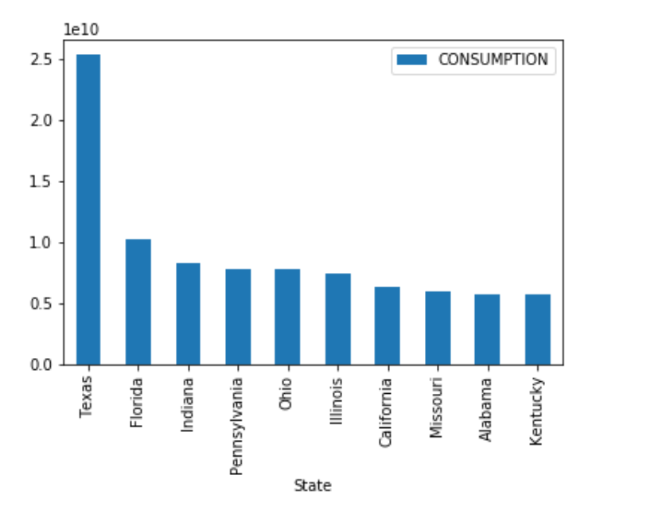
Largest fossil fuel consuming states

Slide 6
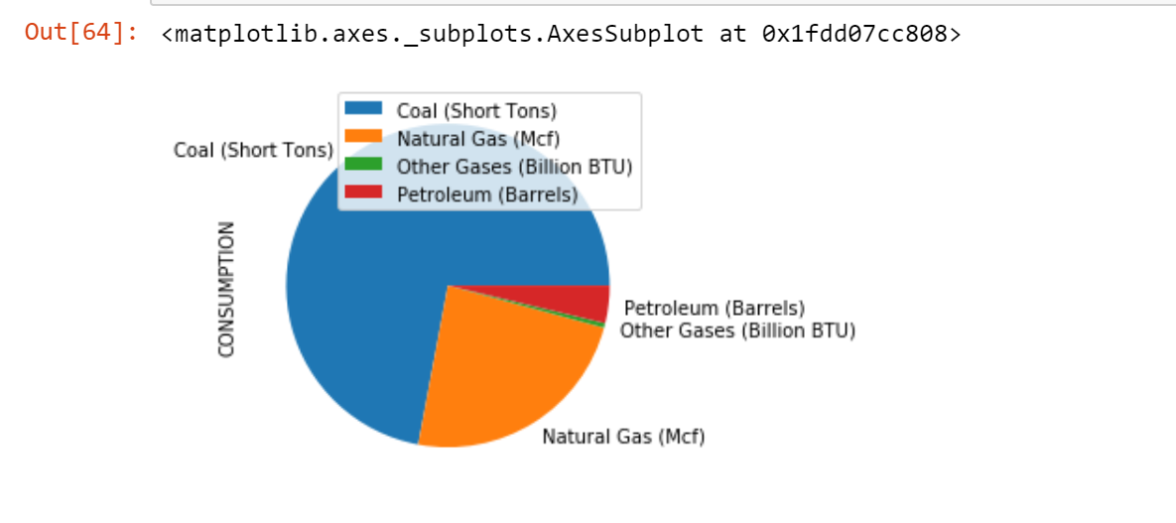
Fossil fuel type share

